Slide 1
IM Proposal
Instant Messaging Proposal
By: Douglas Toblert-Cooke, Andrew Rivera, Linner Rivas

Slide 2
Our Developers & roles
Douglas Tolbert-Cooke
DEV LEAD
Java
GUI
Andrew Rivera
QA LEAD
Java
GUI
Linner Rivas
SCRUM MASTER
Java
SQL
GUI

Slide 3
LANGUAGE/ENVIRONMENT USED
Coded in Java
MySQL
Html/css
JavaScript
Coded using Eclipse
Using Github

Slide 4
Our Developer background

Slide 5
Douglas Tolbert-Cooke
My name is Douglas Tolbert-Cooke and I am a senior majoring in Computer Science. I am equally knowledgeable in Python as I am Java. However, I've only taken half of each one class wise. I'm currently in a Python class so I guess I'm currently better with Python. I've used IDLE and Eclipse as my programming platforms. I have general networking knowledge but anything I do not understand I can obtain the information.

Slide 6
Andrew Rivera
My name is Andrew Rivera, I'm currently a senior going for a bachelor's degree in Computer science, with a focus in Information systems. I have taken multiple classes using java as a programming language and I feel the most comfortable using that for this project. I also have a semester's worth of experience using python, JavaScript, CSS, html, GUI, and SQL. I use brackets and notepad++ as my development platforms for the majority of the coding that I do. I have a general knowledge in networking but nothing of significance.

Slide 7
Linner Rivas
My name is Linner Rivas, I am currently a senior going for my bachelor’s degree in Computer science focused on Computer Information System. I have my associate in computer information system. I have learned the skills of programming in the basic language in java, python, html, css, JavaScript, c++ , c# and I do have a lot of skills base in database(SQL). The development platform that I use a is notepad++ and Visual studio. I have a general knowledge of networking but if I have a problem or I don’t understand, I would google it anything on networking. I work in a IT, networking and development company.

Slide 8
Possible Layout

Slide 9
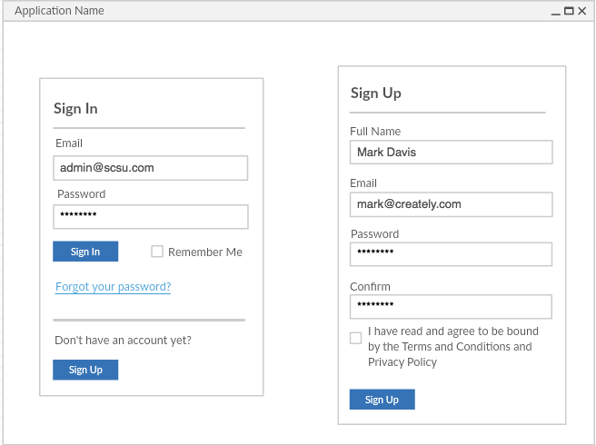
Layout 1
The first page that comes up is the sign in page.
Contents the following:
Sign in area
Sign up area

Slide 10
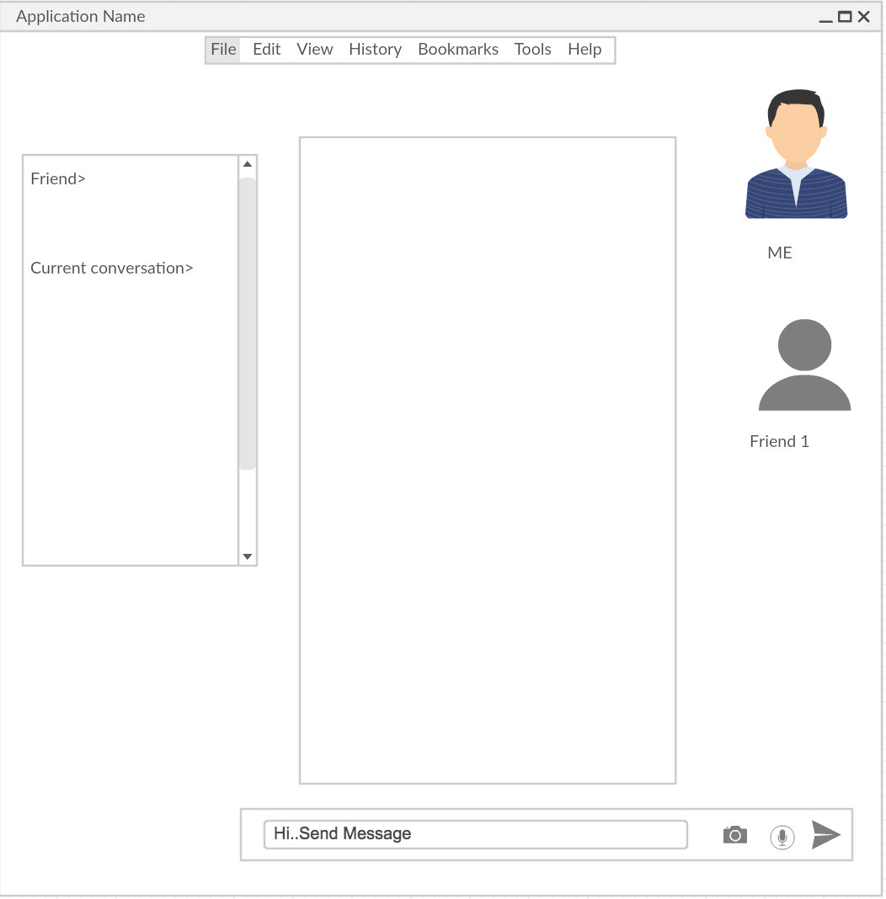
Layout 2
Image of the user or emoji image
The side bar contents the :
Friends that are connected.
Friends that are disconnected.
Your Conversation history.
Text Message input.
Top Bar menu:
File
Edit
View
History
Tools
Help
Message Display

